Slide 1

COURSE
DATE
Web Application Development
20/06/2024
PT BOOKSTORE
Find your favorite, all in one place
GROUP
PRESENTED BY
The Bookstore Builders
Dinh Phuc x Quoc Thang

Slide 2


COURSE
DATE
Web Application Development
20/06/2024
OUR TEAM
DO DINH PHUC - ITCSIU21219
PHAN QUOC THANG - ITCSIU21232
Back-end & Middle
Front-end & UI Design
GROUP
PRESENTED BY
The Bookstore Builders
Dinh Phuc x Quoc Thang

Slide 3
NAME OF PROJECT
TABLE OF CONTENTS
NAME OF COMPANY
your name
your name
1
PROJECT INTRODUCTION
2
DEMO
3
ANALYSIS DESIGN & ARCHITECTURE
4
Q & A

Slide 4
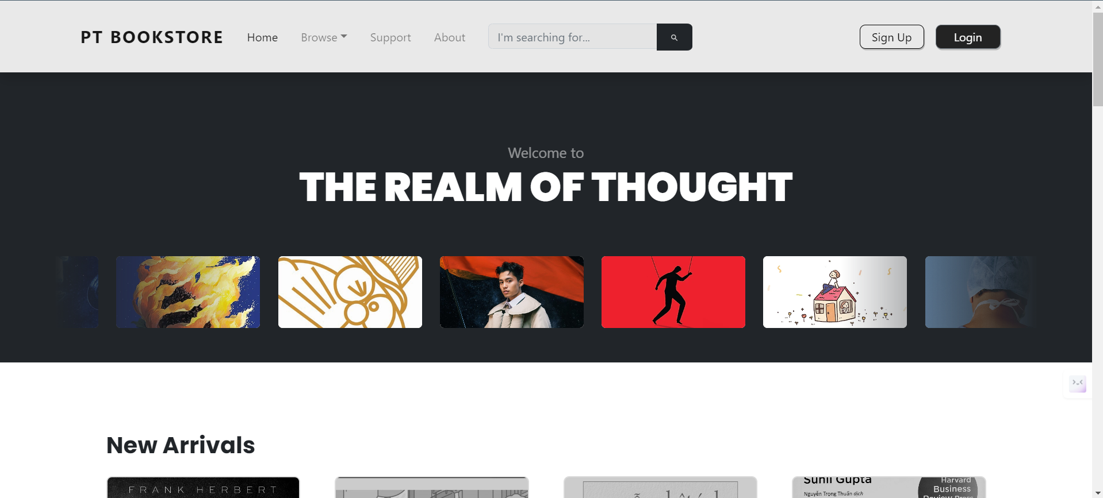
INTRODUCTION

Slide 5
COURSE
Web Application Development
LET’S DEMO
GROUP
The Bookstore Builders

Slide 6
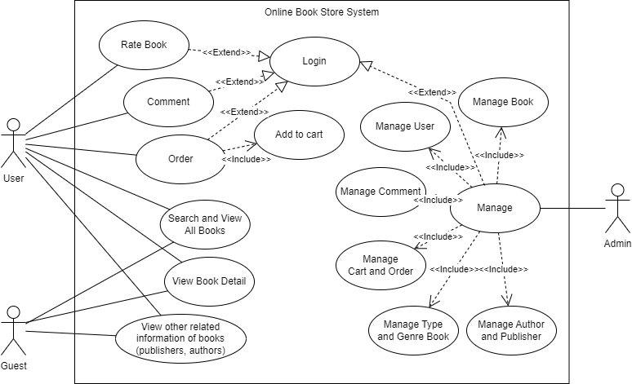
COURSE
Web Application Development
USECASE DIAGRAM
GROUP
The Bookstore Builders

Slide 7

COURSE
Web Application Development
DEVELOPMENT PROCESS
GROUP
The Bookstore Builders

Slide 8
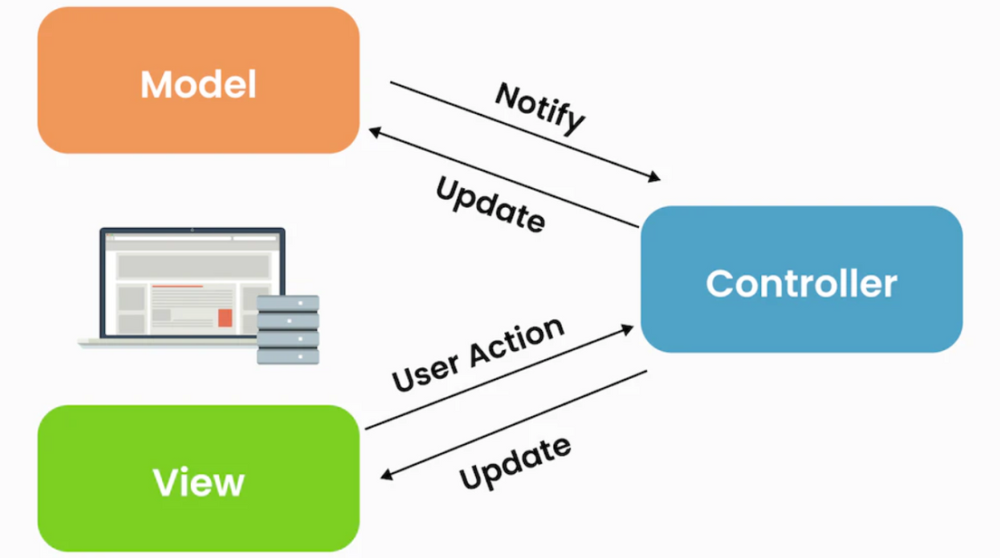
COURSE
Web Application Development
DEVELOPMENT ARCHITECTURE
GROUP
The Bookstore Builders

Slide 9
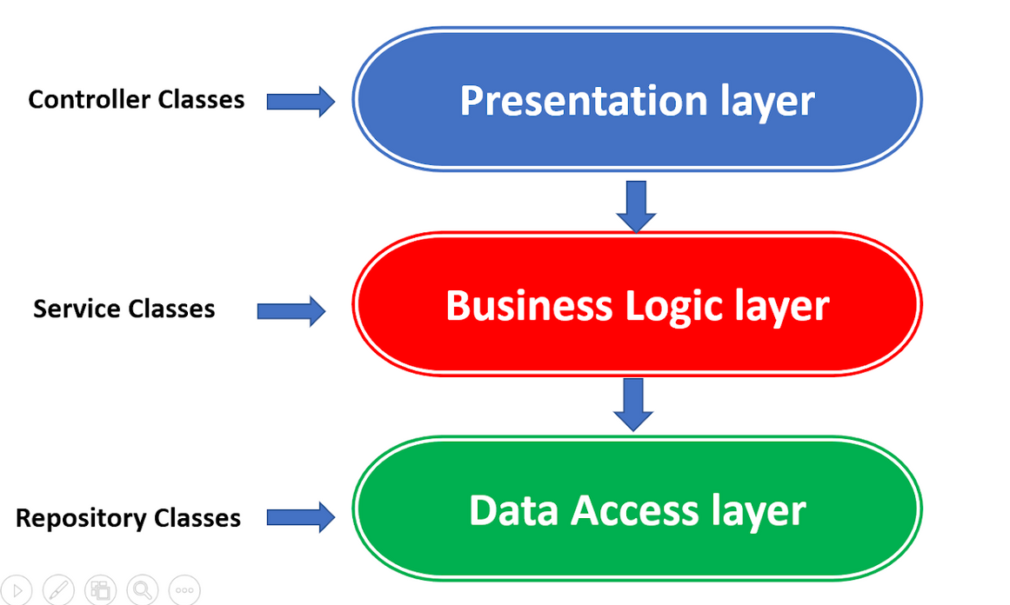
COURSE
Web Application Development
DEVELOPMENT ARCHITECTURE
GROUP
The Bookstore Builders

Slide 10
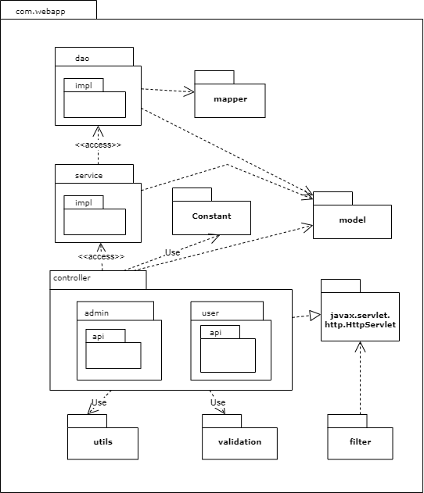
COURSE
Web Application Development
PACKAGE DIAGRAM
GROUP
The Bookstore Builders

Slide 11
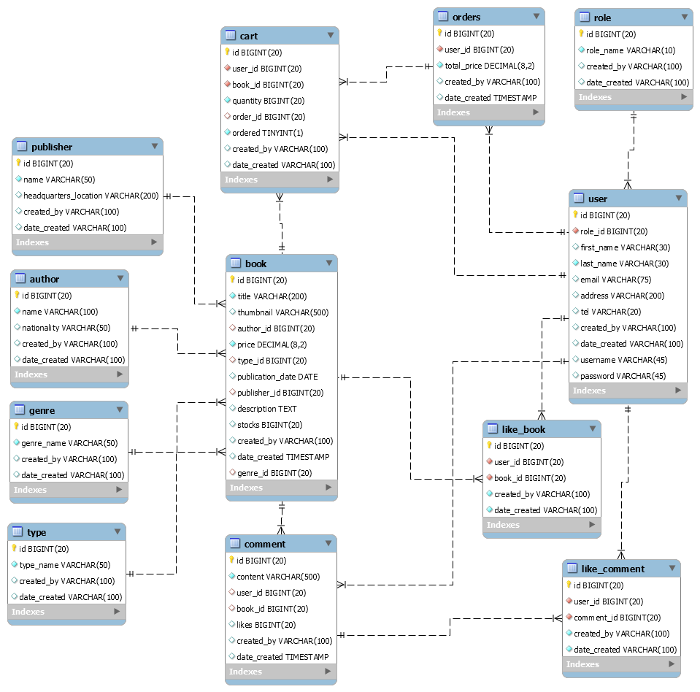
COURSE
Web Application Development
DATABASE - ERD
GROUP
The Bookstore Builders

Slide 12
COURSE
Web Application Development
THANKS FOR LISTENING
Q & A
GROUP
The Bookstore Builders

